Slide 1
Your Product and a
Feasibility Analysis
(Barringer Chapter 3)

Slide 2
Feasibility Analysis
Notes:
https://www.youtube.com/watch?v=0xx7Ft5j83E&t=354s

Slide 3
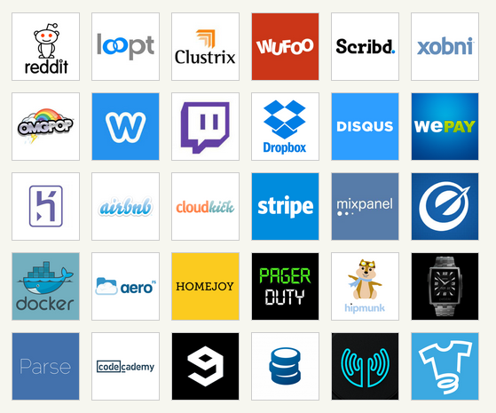
AREC 213 Lecture 3
Feasibility Analysis
Feasibility analysis is the process of determining whether a business idea is viable.
It is the preliminary evaluation of a business idea, conducted for the purpose of determining whether the idea is worth pursuing.
Timing of Feasibility Analysis
The proper time to conduct a feasibility analysis is early in thinking through the prospects for a new business.
The thought is to screen ideas before a lot of resources are spent on them.

Slide 4
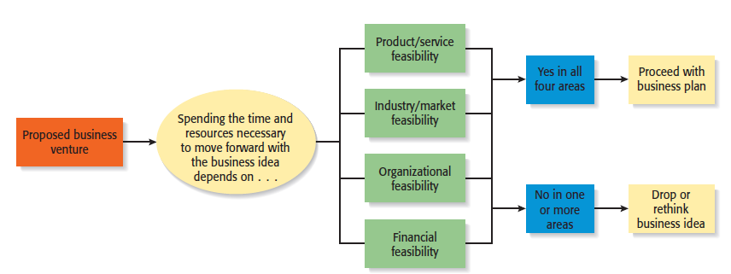
AREC 213 Lecture 3
Role of feasibility analysis in developing business ideas.
Notes:
Hair salon in Corvallis

Slide 5
AREC 213 Lecture 3
Forms of Feasibility Analysis
Product/Service Feasibility
Industry/Target Market
Feasibility
Organizational Feasibility
Financial Feasibility

Slide 6
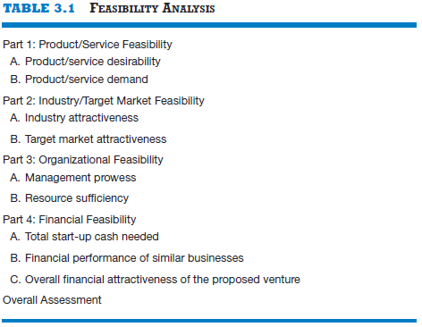
AREC 213 Lecture 3
Outline for a Comprehensive Feasibility Analysis

Slide 7
AREC 213 Lecture 3
Part 1: Product Service Feasibility
Purpose
Is an assessment of the overall appeal of the product or service being proposed.
Before a prospective firm rushes a new product or service into development, it should be sure that the product or service is what prospective customers want.
Components
Product/Service
Desirability
Product/Service
Demand

Slide 8

AREC 213 Lecture 3
Part 1: Product Service Feasibility
Determining Appeal of Idea
Does it make sense?
Is it reasonable?
Is it something consumers will get excited about?
Does it take advantage of an environmental trend, solve a problem, or take advantage of a gap in the marketplace?
Is this a good time to introduce the product or service to the market?
Are there any fatal flaws in the product or service’s basic design or concept?
Colgate Kitchen Entrees

Slide 9
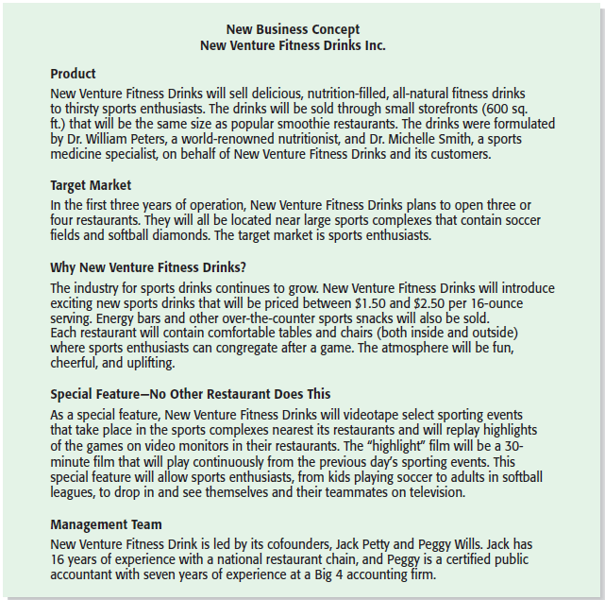
AREC 213 Lecture 3
Part 1: Product Service Feasibility
Develop a Concept Test
A concept statement should be developed.
A concept statement is a one-page description of a business that is distributed to people who are asked to provide feedback on the potential of the business idea.
The feedback will hopefully provide the entrepreneur:
A sense of the viability of the product or service idea
Suggestions for how the idea can be strengthened or “tweaked” before proceeding further.

Slide 10
AREC 213 Lecture 3
Part 1: Product Service Feasibility
Product/Service Demand
There are two steps to assessing product/service demand.
Step 1: Administer a Buying Intentions Survey
Step 2: Conduct Library, Internet, and Gumshoe research

Slide 11
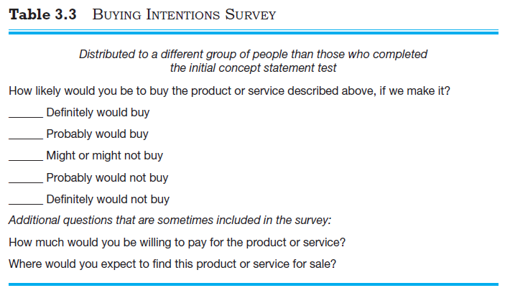
AREC 213 Lecture 3
Part 1: Product Service Feasibility
Step 1: Buying Intentions Survey
Is an instrument that is used to gauge customer interest in a product or service.
It consists of a concept statement or a similar description of a product or survey with a short survey attached to gauge customer interest.
Internet sites like SurveyMonkey make administering a buying intentions survey easy and affordable.

Slide 12
AREC 213 Lecture 3
Part 1: Product Service Feasibility
Step 2: Library, Internet, and Gumshoe Research
The second way to assess the demand for a product or service is by conducting library, Internet, and gumshoe research.
Reference librarians can often point you toward resources to help you investigate a business idea, such as industry-specific trade journals and industry reports.
Internet searches can often yield important information about the potential viability of a product or service idea.
One of the most effective things an entrepreneur can do to conduct a thorough product/service feasibility analysis is to hit the streets and talk to potential customers.

Slide 13
AREC 213 Lecture 3
Part 2: Industry and Target Market Feasibility
Purpose
Is an assessment of the overall appeal of the industry and the target market for the proposed business.
An industry is a group of firms producing a similar product or service.
A firm’s target market is the limited portion of the market it plans to go after.
Components of industry/target market
feasibility analysis
Industry Attractiveness
Target Market
Attractiveness

Slide 14
AREC 213 Lecture 3
Part 2: Industry and Target Market Feasibility
Industry Attractiveness
Industries vary in terms of their overall attractiveness.
In general, the most attractive industries have the characteristics depicted on the next slide.
Particularly important—the degree to which environmental and business trends are moving in favor rather than against the industry.
Are young rather than old
Are early rather than late in their life cycle
Are fragmented rather than concentrated
Are growing rather than shrinking
Are selling products and services that customers “must have” rather than “want to have”
Are not crowded
Have high rather than low operating margins
Are not highly dependent on the historically low price of key raw materials

Slide 15
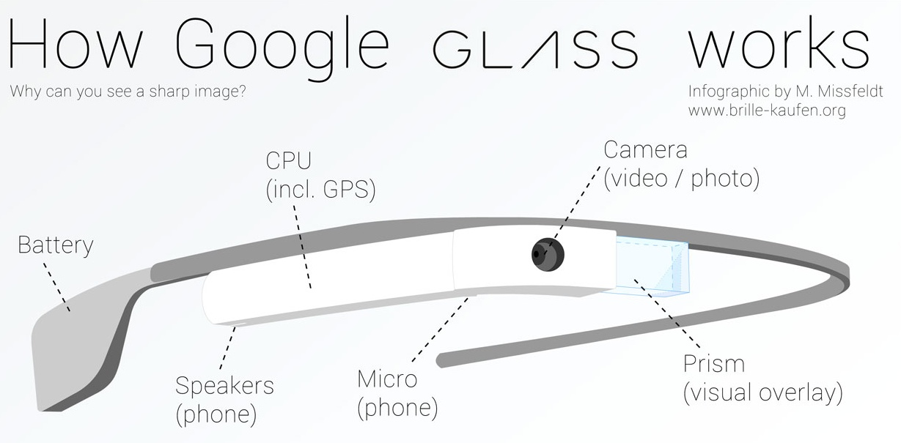
AREC 213 Lecture 3
Part 2: Industry and Target Market Feasibility
Target Market Attractiveness
The challenge in identifying an attractive target market is to find a market that’s large enough for the proposed business but is yet small enough to avoid attracting larger competitors.
Assessing the attractiveness of a target market is tougher than an entire industry.
Often, considerable ingenuity must be employed to find information to assess the attractiveness of a specific target market.
What is the target market for Google Glass

Slide 16
AREC 213 Lecture 3
Part 3: Organizational Feasibility
Purpose
Is conducted to determine whether a proposed business has sufficient management expertise, organizational competence, and resources to successfully launch a business.
Focuses on non-financial resources.
Components of organizational
feasibility analysis
Management Prowess
Resource Sufficiency

Slide 17
AREC 213 Lecture 3
Part 3: Organizational Feasibility Management Prowess
A proposed business should candidly evaluate the prowess, or ability, of its management team to satisfy itself that management has the requisite passion and expertise to launch the venture.
Two of the most important factors in this area are:
The passion that the sole entrepreneur or the founding team has for the business idea.
The extent to which the sole entrepreneur or the founding team understands the markets in which the firm will participate.

Slide 18
AREC 213 Lecture 3
Part 3: Organizational Feasibility
Resource Sufficiency
This topic pertains to an assessment of whether an entrepreneur has sufficient resources to launch the proposed venture.
To test resource sufficiency, a firm should list the 6 to 12 most critical nonfinancial resources that will be needed to move the business idea forward successfully.
If critical resources are not available in certain areas, it may be impractical to proceed with the business idea.
Examples of nonfinancial resources that may be critical to the successful launch of a new business
Affordable office space
Lab space, manufacturing space, or space to launch a service business
Availability of contract manufacturers or service providers
Key management employees (now and in the future)
Key support personnel (now and in the future)
Ability to obtain intellectual property protection
Ability to form favorable business partnerships

Slide 19
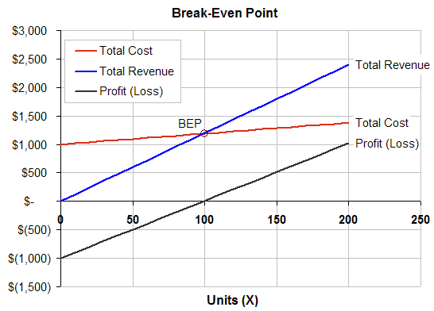
AREC 213 Lecture 3
Part 4: Financial Feasibility
Purpose
Is the final component of a comprehensive feasibility analysis.
A preliminary financial assessment is sufficient.
Components of financial
feasibility analysis
Total Start-Up Cash
Needed
Financial Performance of
Similar Businesses
Overall Financial
Attractiveness of the
Proposed Venture

Slide 20
AREC 213 Lecture 3
Part 4: Financial Feasibility
Total Start-Up Cash Needed
The first issue refers to the total cash needed to prepare the business to make its first sale.
An actual budget should be prepared that lists all the anticipated capital purchases and operating expenses needed to generate the first $1 in revenues.
The point of this exercise is to determine if the proposed venture is realistic given the total start-up cash needed.

Slide 21
AREC 213 Lecture 3
Part 4: Financial Feasibility
Financial Performance of Similar Businesses
Estimate the proposed start-up’s financial performance by comparing it to similar, already established businesses.
There are several ways to doing this, all of which involve a little ethical detective work.
First, there are many reports available, some for free and some that require a fee, offering detailed industry trend analysis and reports on thousands of individual firms.
Second, simple observational research may be needed. For example, the owners of New Venture Fitness Drinks could estimate their sales by tracking the number of people who patronize similar restaurants and estimating the average amount each customer spends.

Slide 22
AREC 213 Lecture 3
Part 4: Financial Feasibility
Overall Financial Attractiveness of the Proposed Investment
A number of other financial factors are associated with promising business start-ups.
In the feasibility analysis stage, the extent to which a business opportunity is positive relative to each factor is based on an estimate rather than actual performance.
Financial Factors Associated With Promising Business Opportunities
Steady and rapid growth in sales during the first 5 to 7 years in a clearly defined market niche
High percentage of recurring revenue—meaning that once a firm wins a client, the client will provide recurring sources of revenue
Ability to forecast income and expenses with a reasonable degree of certainty
Internally generated funds to finance and sustain growth
Availability of an exit opportunity for investors to convert equity to cash

Slide 23
Product

Slide 24
AREC 213 Lecture 3
What problem are you solving?
What are you selling?
Who are your customers (Who will Buy It?

Slide 25
AREC 213 Lecture 3
Features of Your Product and Service
If you can’t describe your product/service clearly you can’t sell it
You know your product so well that you probably assume everyone else does, too.
You must see your product through your customers eyes

Slide 26
AREC 213 Lecture 3
Defining Terms
Product – Each individual goods or service you provide.
Feature – Each unique aspect of your product or service.
Benefit – What the customer will gain from using this product or service feature.

Slide 27
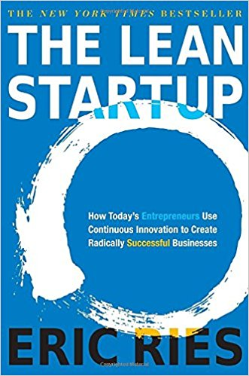
AREC 213 Lecture 3
Product and Service Description
Whole Product Concept
Everything Needed/Delivered to Customer
Product
Product Options
Packaging
Accessories
Consumables
Replacement Parts
Training
Manuals
Support

Slide 28
AREC 213 Lecture 3
Who is Your Customer
We all assume we know who our customer is.
But what if we’re missing something
Who else might buy your product
Consider the Features and Benefits from various customer perspectives.

Slide 29
Excel

Slide 30
AREC 213 Lecture 3
Charts
Cell SS
Average
Standard Deviation
Data Sorting

Slide 31
Web Sites

Slide 32
AREC 213 Lecture 3
Purchasing a Domain
Pop.co
Godaddy
namecheap
Hosting Your Site
Dreamhost
Hostgator
Godaddy

Slide 33
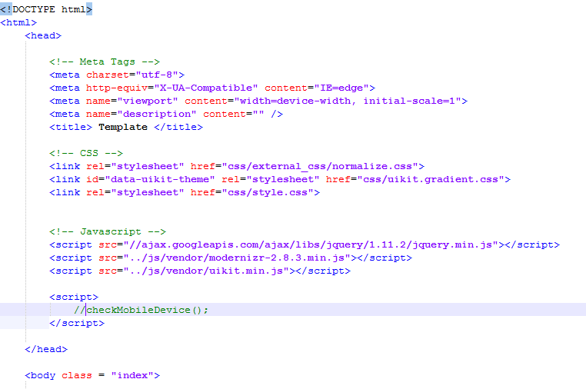
AREC 213 Lecture 3
Client
JavaScript
Server
PHP
Python
Java
Ruby on Rails
C#
Node (JavaScript)
Templates
Frameworks
Jquery
HTML and CSS

